Slide 1

By:
Nythiennzo
Kavi
Fisayo
Arjun

Slide 2


Slide 3

ROADMAP Introduction!
What is GitHub ?
Configuring Git
Basic Git Commands line
Terminology

Slide 4
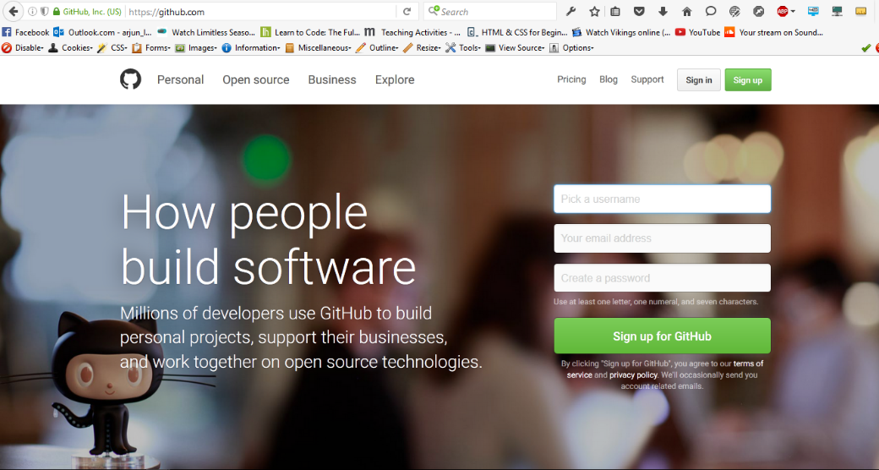
GitHub
GitHub is a web-based hosting service for Git
Allows users to “Push” and “Pull” their local repositories to and from remote repositories on the web
Provides users with a homepage that displays public repos
Allows users to create account, follow each other and share projects.
Download: http//github.com/

Slide 5
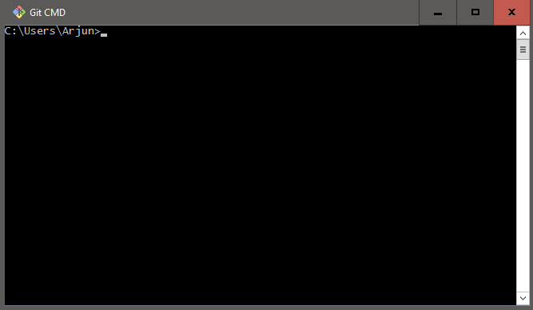
Git
Git is a version control system
Created by Linus Torvalds
Operated from command line
Everything is stored in Repository

Slide 6
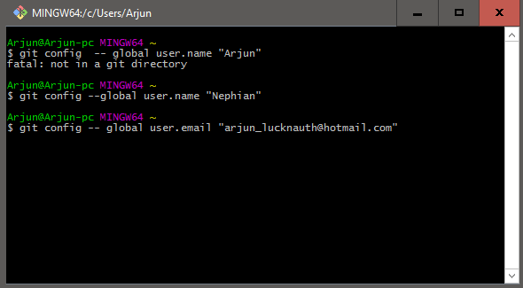
Configuring Git
git config --global user.name "Your Name Here"
git config --global user.email "your_email@youremail.com"

Slide 7
Terminology used on GitHub
Repository
“Forking”
Clone
Pull
Add
Commit
Push
Branch
Master
Users
Users
Users
Users

Slide 8
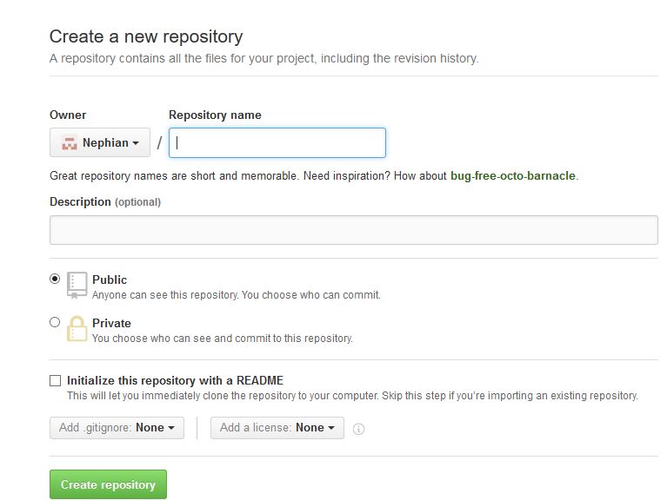
Creating a GitHub Repository
Two methods of creating a GitHub repository :
Start a repository from scratch
“Fork” another user’s repository
https://github.com/”YourUserName”
Create a name for a repo, select “public”, make a brief description and click on “create repository”.

Slide 9
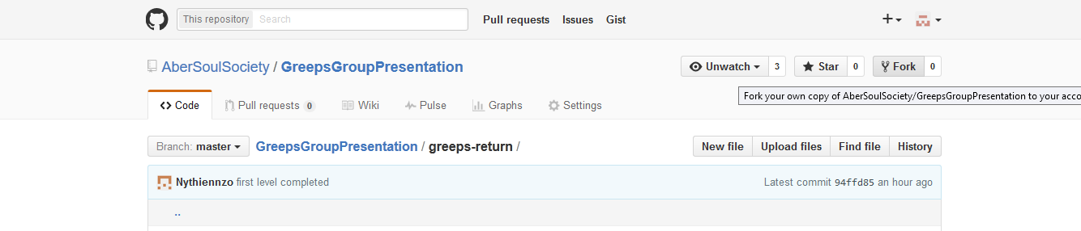
“Forking”
The second method of creating a repo is by making a copy of someone else’s.
This process is called “forking”
Go on Github > Explore>click on a project you are interested.
Click on Fork

Slide 10
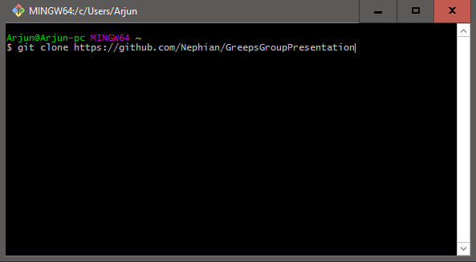
Clone the repo
So there’s a copy of the repo in your Github account.
You need to make a copy on your local computer.
This process is called “cloning”. You can do it with the following command:
Git clone https//github.com/YourUserName/Name of forked file.

Slide 11
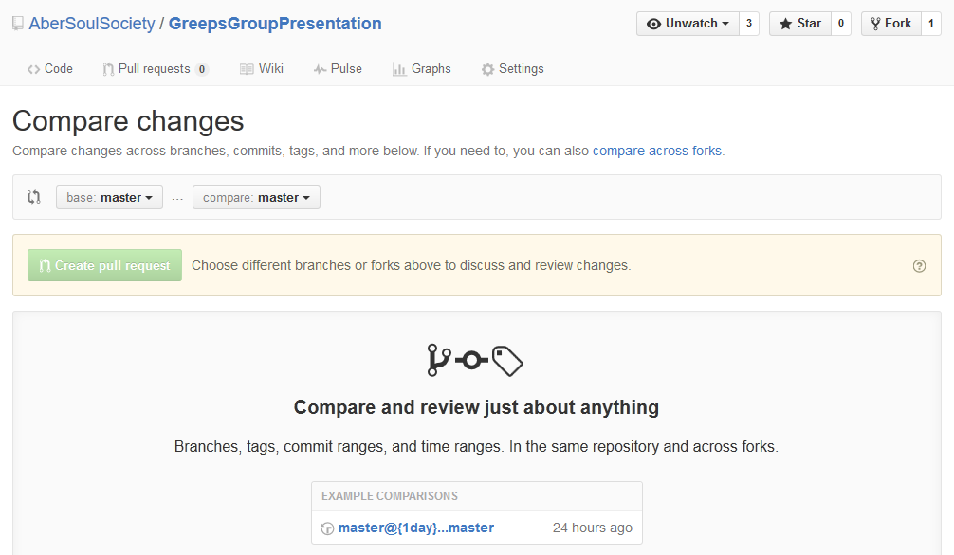
Pull request
Allows other people to see changes you made.
People interested can review changes, discuss modifications and even push follow up.
You can pull request from Github’s website. This will enable you to compare work.

Slide 12
Adding
If you add new files to a local repo, you need to let Git know so that it is tracked.
Note : This should always be done before committing.
You can use the following commands.
git add –u (updates tracking for files that changed names or were deleted
git add-A Does both of the previous steps.

Slide 13
Committing
Permanently Stores changes from Staging Area to another version on remote repository
Note : This should always be done before pushing.
You can use the following commands.
git commit –m (include a message between double commas)

Slide 14
PUSHING
Uploads the new version to GitHub.
You can use the following commands.
git push (You may need to input your credentials)

Slide 15
Branches
Create branch of Master project so that other people can work at the same time as you are.
To branch a repo you can use this command
$ git checkout –b ” branchname”
To see what branch you are on:
$ git branch
To switch back to the master branch type:
$ git checkout master
$git merge “branchname”
To merge a branch with the current branch(usually master)

Slide 16
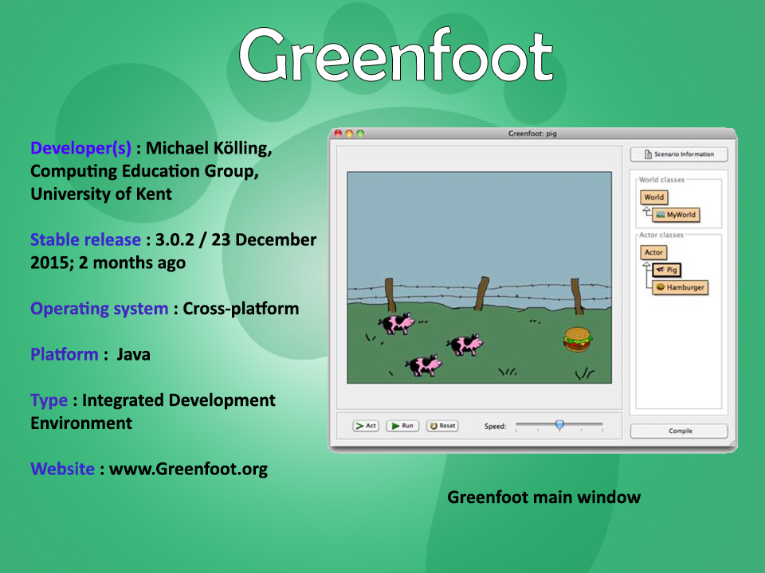
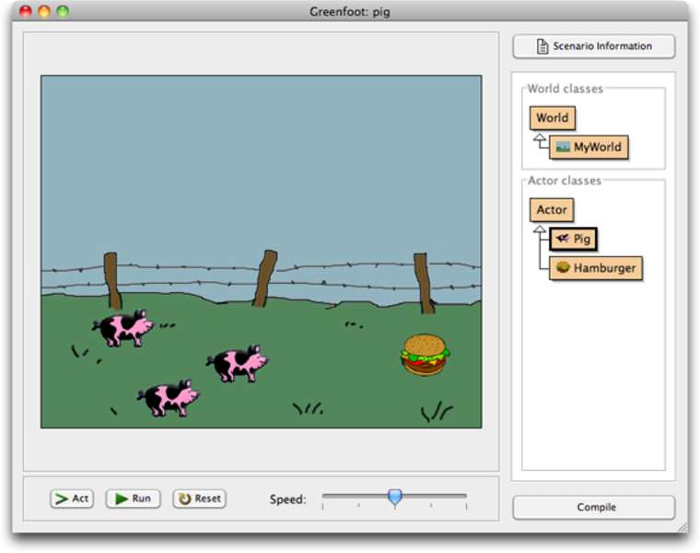
Greenfoot
Developer(s) : Michael Kölling, Computing Education Group, University of Kent
Stable release : 3.0.2 / 23 December 2015; 2 months ago
Operating system : Cross-platform
Platform : Java
Type : Integrated Development Environment
Website : www.Greenfoot.org

Slide 17
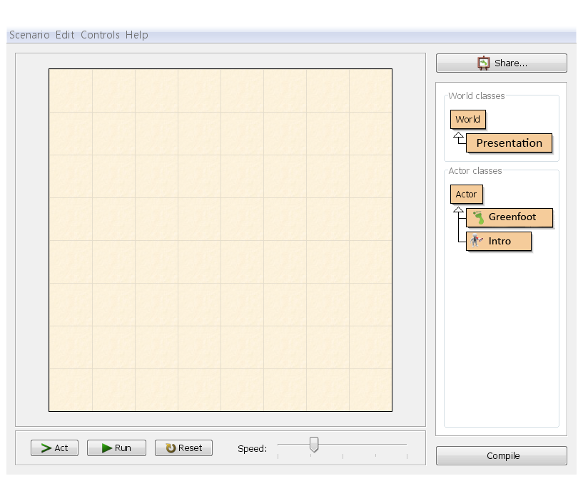

Greenfoot
Greenfoot is an interactive Java development environment designed primarily for educational purposes at the high school and undergraduate level, to help beginners gain experience with object-oriented programming.
Nutshell: Greenfoot is a tool for teaching programming with java language
It a combination between a framework for two-dimensional graphical applications in Java and an IDE, that allows development such as simulations and interactive games.

Slide 18
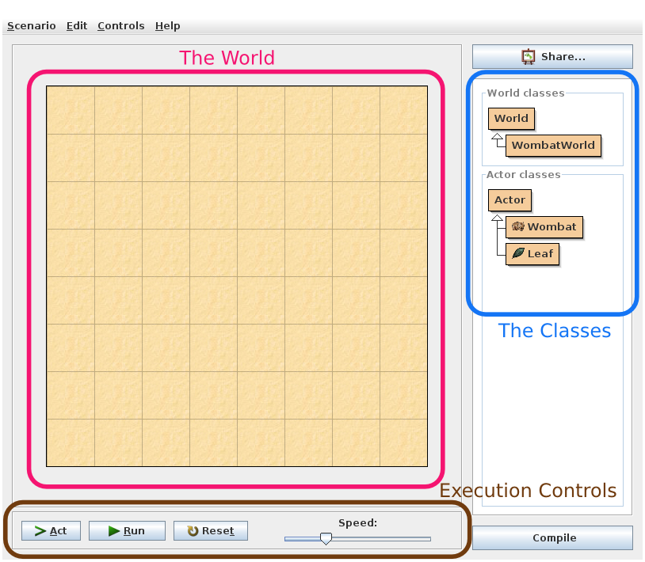
Visual Interface

Slide 19
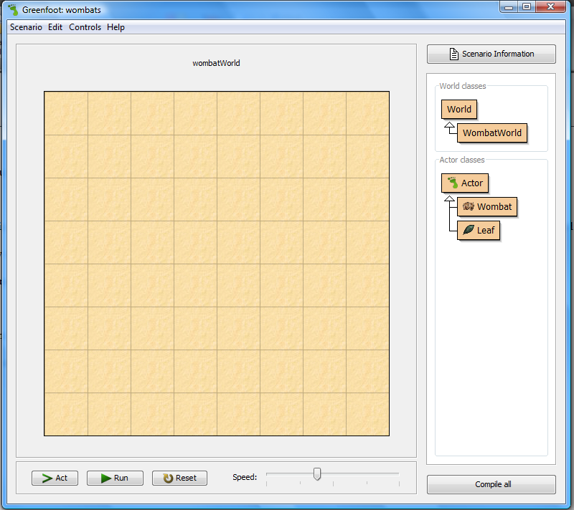
The World: Where we will see things happen.
World

Slide 20
Class Diagram: It shows us the classes involved in the scenario
The classes World and Actor will always be there – they come with the Greenfoot system.
The classes are specific to the wombat scenario. They may be different or not exist at all in other scenarios.
Once we have a class in Greenfoot (or Java), we can create objects from it.
Class
Diagram

Slide 21
Execution Controls
The Act button: invoke the act() method of every object exactly once.
The Run button is equivalent to continuously clicking the Act button.
The slider to the right of the buttons sets the speed.
Execution
Controls

Slide 22
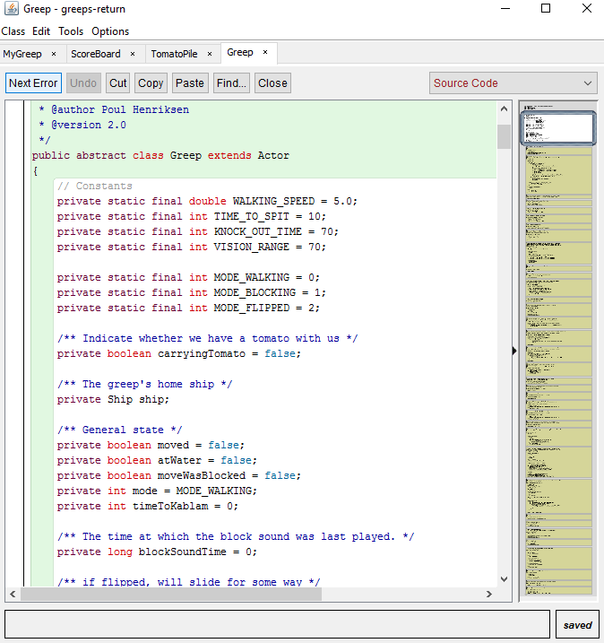
The text editor
Can be used to view the source code
Used to write the different classes.
Can also be turned to a documentation.

Slide 23
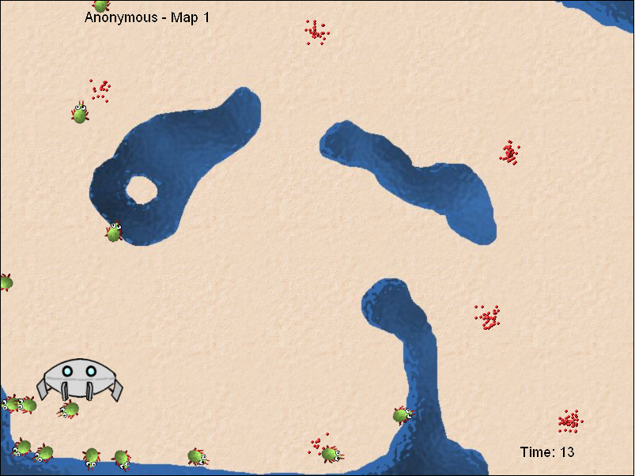
Greeps
Developed by : Michael Kolling
Released in : Feb 2007
Gameplay: 2D –Top View, control with codes

Slide 24
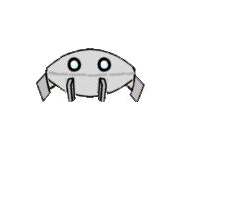


Greeps
A fun competition that teaches Java programming and computational problem-solving.
The programming experience needed to tackle this the greeps is quite modest: you need an understanding of variables, method calls with parameters, and if statements.
This exercise not only teaches Java—it gives people practice in computational problem-solving
Objectives: Write codes to help the greeps to collect the tomatoes.

Slide 25


Slide 26
New updates
New features:
4 new maps
2 packs of greeps instead of 1
New powers:
kablam();
block();
getFriend();
turnTowards();

Slide 27
RULES
Rule 1
Only change the class 'MyGreep'.
Rule 2
You cannot extend the Greeps' memory.
Rule 3
You can call any method defined in the "Greep" superclass, except act().
Rule 4
Greeps have natural GPS sensitivity..
Rule 5
No creation of objects.
Rule 6
You are not allowed to call any methods of any other class in this scenario.

Slide 28
The Modifications
We made

Slide 29
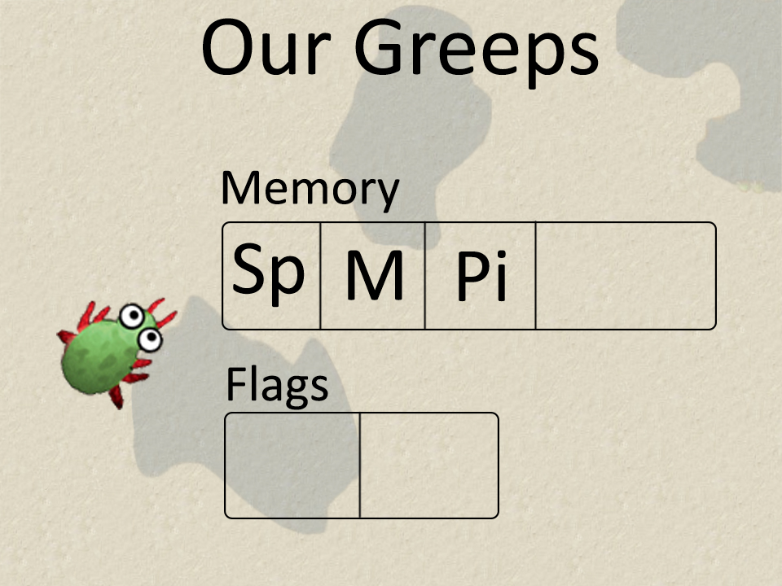

Slide 30
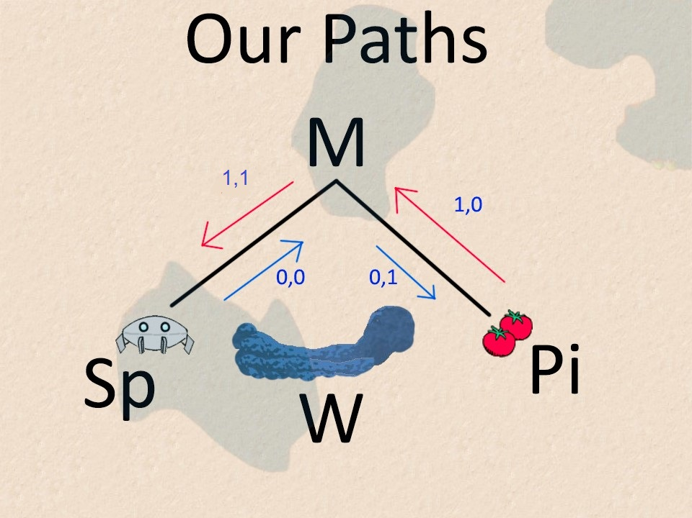

Slide 31
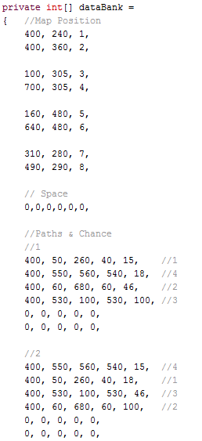
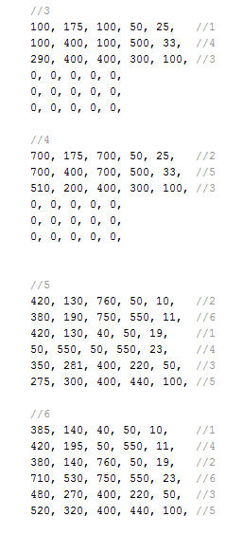
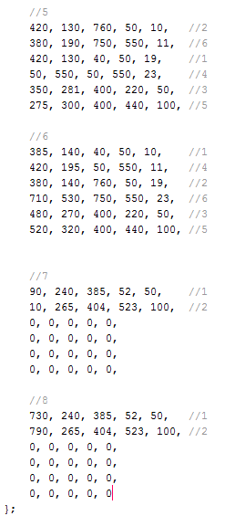
Our Ship databank[]

Slide 32
Our methods
void:
figurePosition()
setFlag() //overridden
setGreep()
boolean:
isAtShipWithoutTomato()
isAtShipWithTomato()
isInZoneAroundXY(int X, int Y)
isInZoneWithoutTomato(int X, int Y)
isInZoneWithTomato(int X, int Y)
int:
mergeXY(int X, int Y)
resolveX(int code)
resolveY(int code)

Slide 33
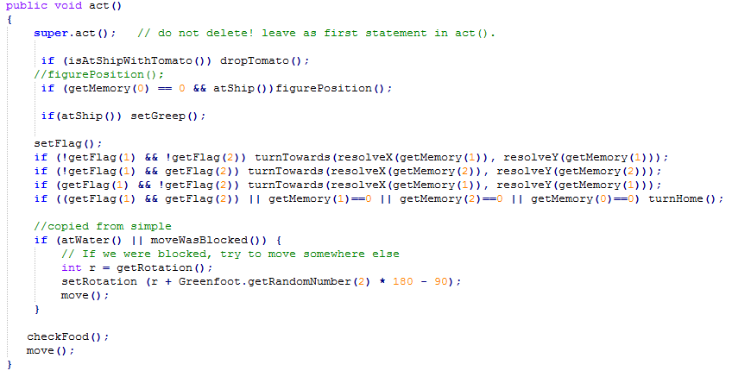
Our Act()method

Slide 34
The Experience we had

Slide 35
What we learnt
How to use GitHub
How to use GreenFoot
About Object Oriented Programming
How to guide the Greeps
How to work in group & communicate

Slide 36
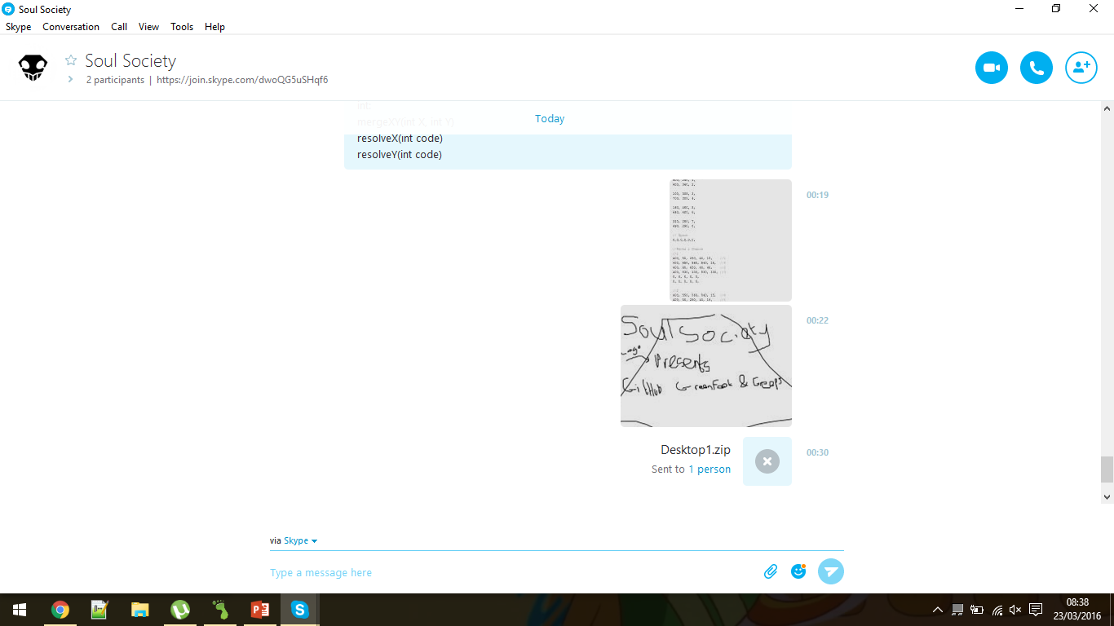
Communication
We shared ideas mostly via Skype.
Skype was also used to send data.
We used Email to contact Fisayo

Slide 37
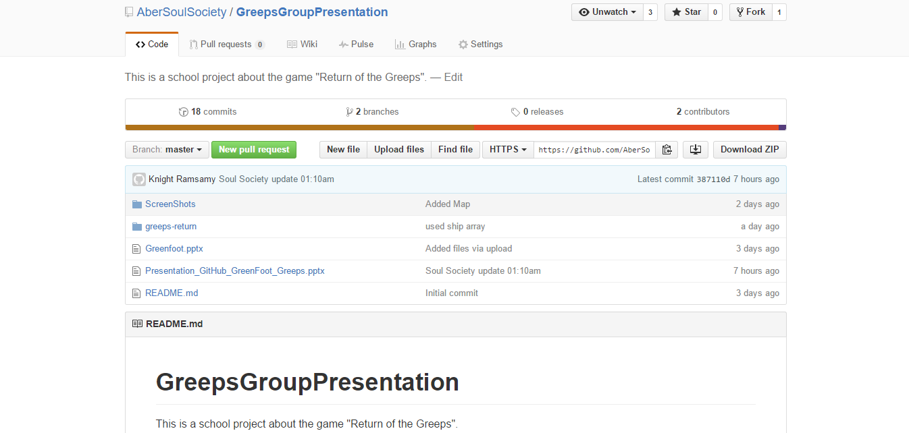
Sharing Data & Keeping track of updates
We kept others updated using GitHub
GitHub was also used to revert to the last working version

Slide 38
Working in groups
Pros.
The work can be divided among the group
The subject is viewed from different points
Everyone can contribute with their ideas and data
Cons.
The startup can be hard
Decisions have to be approved by the whole group
Difficult to communicate with each other

Slide 39
Questions?

